Slide 1

Offline-First NFC Payment System: Revolutionizing POS
Discover an innovative payment solution designed for instant, reliable transactions, even without internet connectivity.
Kunwwer.ai

Slide 2




The "Tap & Go" Philosophy
Our core philosophy centers on a seamless, immediate payment experience for buyers and robust, offline-capable transaction initiation for sellers.
Instant Transactions
Offline Reliability
Tap and go without delays.
No network needed at POS.
Deferred Reconciliation
Syncs when online.
Kunwwer.ai

Slide 3
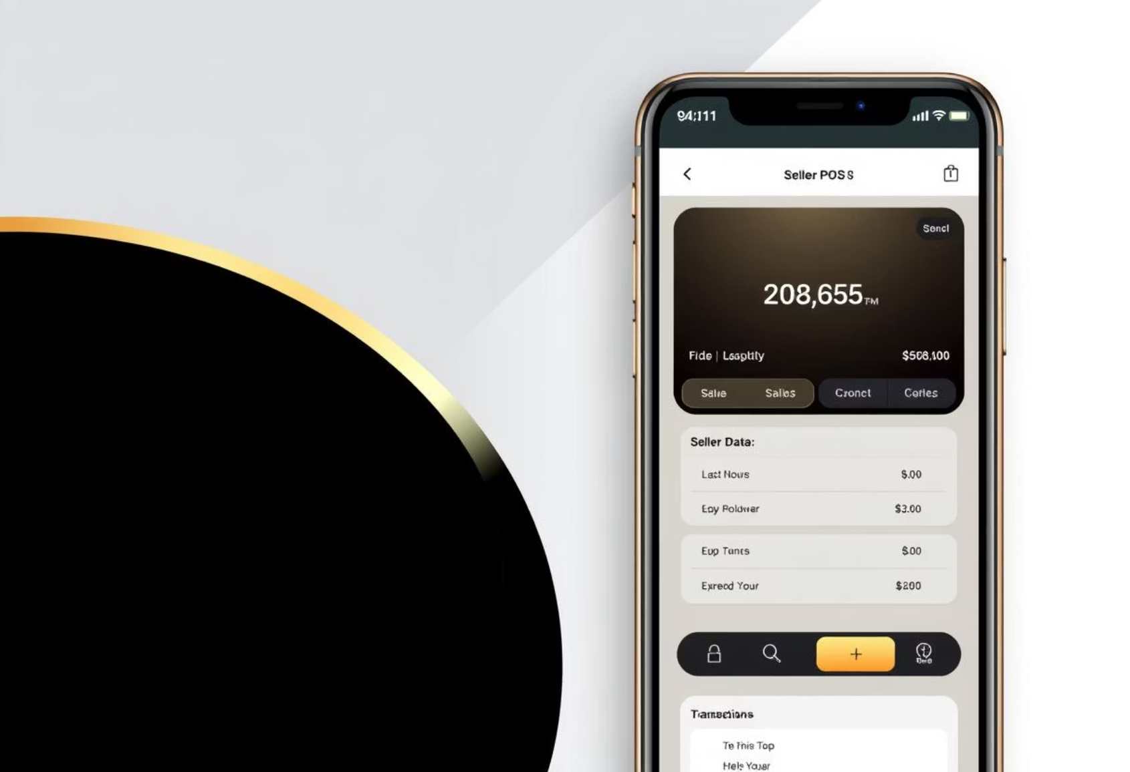
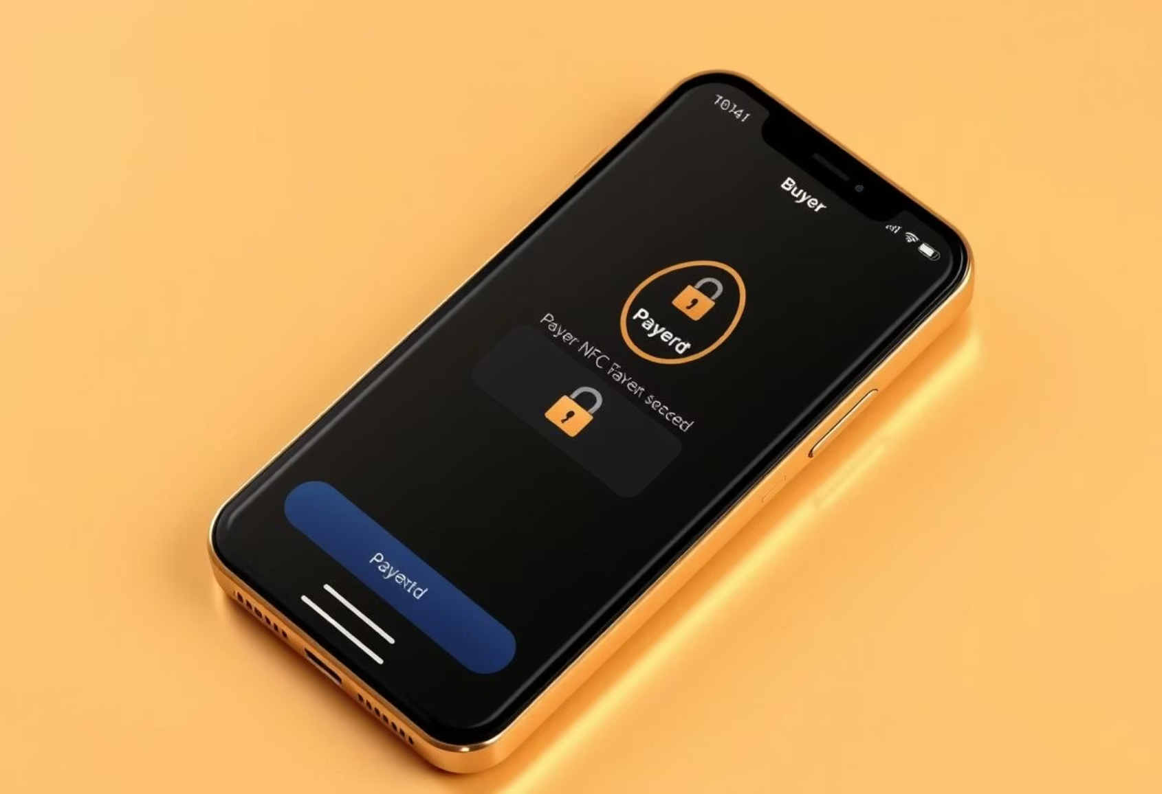
Key Components: Two Specialized Apps
Seller POS Application
Buyer NFC Payment System
Portable POS terminal and NFC reader.
Transforms phone into secure payment instrument.
For merchants, street vendors, and businesses.
For consumers seeking fast, secure, offline payments.
Features: Bill generation, transaction history, optional inventory, KYC status, photo display.
Features: Pre-authorized tokens, secure element, real-time limits, biometric data storage.
Kunwwer.ai

Slide 4





Phase 1: Onboarding & KYC
A one-time online setup ensures security and sets transaction parameters for both buyers and sellers.
Buyer Onboarding
Link payment methods and activate the app/feature.
KYC Verification
Comprehensive ID, address, and facial recognition for security.
Limit Assignment
Dynamic offline transaction limits based on KYC.
Token Generation
Secure pool of cryptographic offline payment tokens.
Seller Onboarding
Merchants register, link accounts, and configure NFC reader.
Kunwwer.ai

Slide 5
Phase 2: The Offline Transaction
Experience instant, secure payments at the point of sale, completely offline.
1
Seller Initiates Bill
POS app displays total amount due, prompts buyer tap.
2
Buyer Taps Phone
No app opening needed; NFC chip triggers payment.
3
Offline Authorization
Phone transmits pre-generated token to POS for instant verification.
4
Facial Recognition
Seller visually confirms buyer's identity via displayed photo.
5
Immediate Confirmation
Instant "Payment Successful - Offline" confirmation on both devices.
6
Offline Record Keeping
Transaction details are securely recorded locally.
Kunwwer.ai

Slide 6
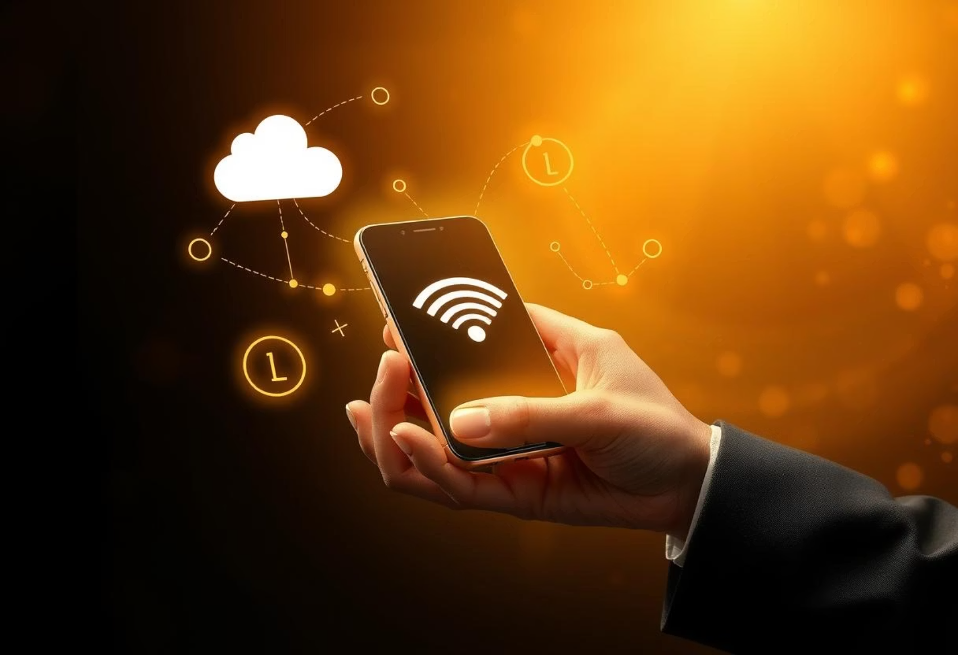
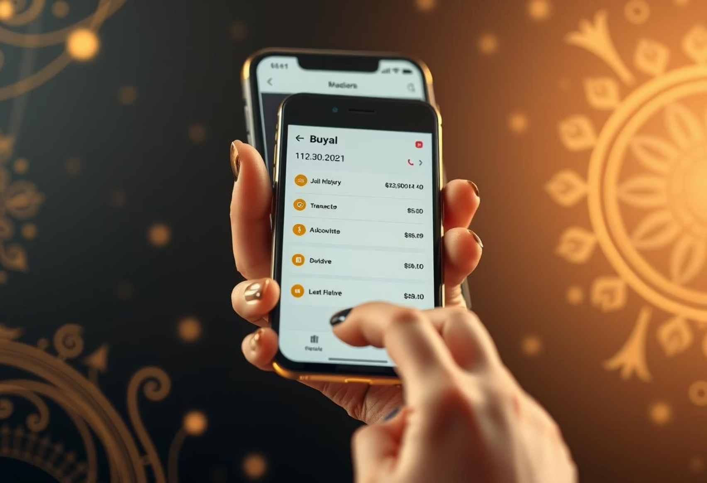
Phase 3: Online Reconciliation
When connectivity is restored, all offline transactions are seamlessly reconciled and settled.
Seller Reconciliation
Buyer Reconciliation
POS app uploads pending transactions.
Buyer's phone syncs with central server.
Payment gateway processes payments and credits seller.
Receives confirmation of processed transactions.
Tokens validated to prevent fraud.
New offline tokens pushed to device.
Kunwwer.ai

Slide 7
Robust Security Measures
Our system prioritizes robust security through multiple layers of protection.
Cryptographic Tokens
KYC & Limits
Strong encryption ensures secure, single-use tokens.
Strict verification sets appropriate offline spending limits.
Fraud Detection
Secure Element
Central system monitors for unusual patterns and token reuse.
Optional hardware integration for enhanced key protection.
Token Expiration
Facial Biometrics
Time-based limits reduce vulnerability.
Secure handling and transmission of facial data with strong privacy.
Kunwwer.ai

Slide 8

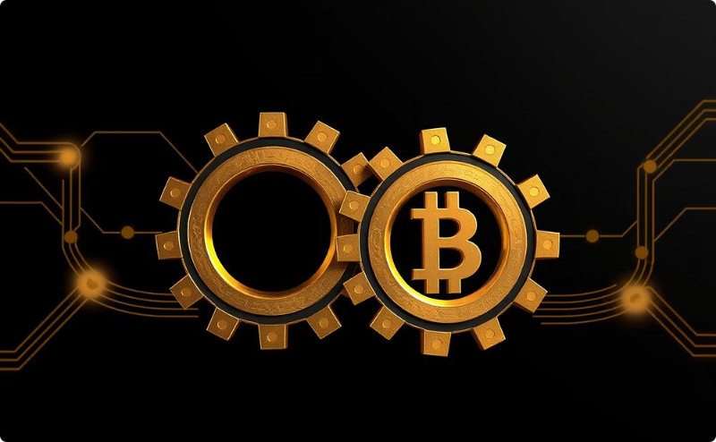
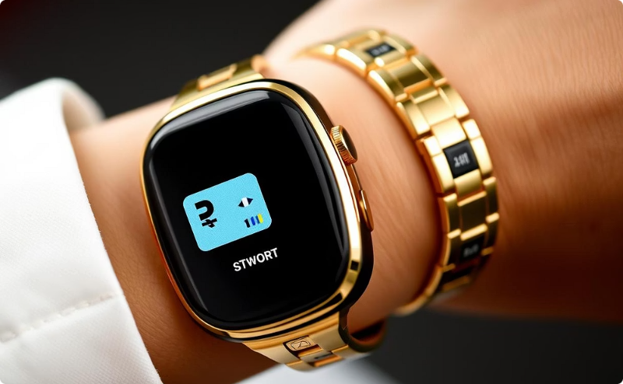

Creative Enhancements & Future Scope
We envision an evolving system with continuous innovation and expanded capabilities.
Dynamic Offline Limits
Multi-Token Transactions
Wearable Integration
Peer-to-Peer Payments
Payments via smartwatches for ultimate convenience.
Adjusts based on spending habits and real-time scores.
Chain tokens for larger offline payments.
Future potential for low-value transfers.
Kunwwer.ai

Slide 9


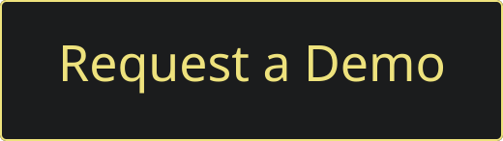
Key Takeaways & Next Steps
The Offline-First NFC Payment System offers a compelling solution for instant payments, especially where connectivity is a challenge.
Seamless Experience
Fast, reliable transactions for both buyers and sellers.
Enhanced Security
Multi-layered approach with cryptographic tokens and KYC.
Future-Proof
Scalable architecture with exciting potential for new features.
Call to Action
Let's discuss how this system can empower your business or enhance your daily transactions.
Kunwwer.ai

